Slide 1

Project Title: Behavioral Finance Patterns in Predicting Global Financial Crises: An Analytical Approach to Crisis Forecasting
Domain: Economics & Finance
Final Review
Course Code: CS6510
Course Title: Project 1
Register Number: 23MSP3068
Name: Dharshani A.
Date: 12-12-2023

Slide 2
Abstract
The financial sector is ever-evolving, and there's a critical need for models that can predict crises before they occur. This study focuses on developing a predictive model for forecasting financial crises by examining extensive historical economic data, market trends, and information from previous global financial downturns. This is achieved by utilizing data from Global Financial Crisis Analytics, incorporating SARIMAX time series analysis, and employing advanced machine learning techniques, including LSTM neural networks. These methods are used to identify economic patterns and interactions.
The research aims to achieve two main objectives: predicting global financial crises and exploring the underlying causes of economic fluctuations. The approach combines principles of behavioral finance with analytical rigor, utilizing both regression analysis and pattern recognition to predict and understand financial instability. The analysis reveals a significant correlation between certain economic indicators and the onset of financial crises.
The results of this research carry important implications for policy formulation and investment decision-making. They offer new strategies for mitigating financial risks and strengthening the economy's resilience against turbulence. By merging proven econometric methods with cutting-edge machine learning technologies, including LSTM neural networks, this study provides new insights into behavioral finance and a robust framework for anticipating economic downturns.
Keywords: Global Financial Crisis, Predictive Modeling, Economic Indicators, Machine Learning, Time Series Analysis, ARIMA, SARIMAX, LSTM Neural Networks, Logistic Regression Analysis, Behavioral Finance.

Slide 3
Introduction
This research provides a thorough exploration of the factors that shape financial dynamics, particularly emphasizing the examination of historical economic data and market behaviors during past global financial downturns. Leveraging datasets from the Global Financial Crisis Analytics, the study introduces a groundbreaking methodology that combines SARIMAX time series analysis with state-of-the-art machine learning techniques, including logistic regression and LSTM neural networks. This approach is innovative in its ability to identify early signals of financial crises.
Building upon existing financial analysis methods, this research integrates advanced technological advancements to refine these approaches. At its core, the study focuses on analyzing historical data and market behaviors, utilizing both SARIMAX and machine learning models for detailed and nuanced pattern detection. This strategy marks a significant progression in the field of financial forecasting, transitioning from traditional models like ARIMA to more complex and effective algorithms, including machine learning and neural networks.
The research draws from a wide array of sources and methodologies, ranging from traditional econometric models to cutting-edge machine learning applications. It covers a broad spectrum of topics related to financial crises, from banking regulations to corporate risk disclosures, and economic recession forecasting. These comprehensive insights inform the direction of the study, highlighting the evolving trend towards the integration of machine learning with traditional financial analysis methods. This fusion aims to enhance the accuracy and reliability of financial crisis predictions and analysis, representing a notable advancement in the field of economic forecasting.

Slide 4
Objectives
1. To undertake data preprocessing and conduct exploratory analysis on the chosen dataset.
2. To design a model that utilizes the SARIMAX technique, known for its ability to analyze seasonal fluctuations, for the four types of crises (Banking, Systemic, Currency, and Inflation).
3. To apply LSTM networks to explore and model intricate temporal relationships within economic time-series data.
4. To innovate a hybrid methodology that combines the strengths of machine learning with econometric models to improve prediction accuracy.
5. To execute a comparative study to evaluate the performance of the proposed hybrid models against established forecasting techniques.

Slide 5
Review of Related Literature
Title of the Paper | Authors | Journal Name/ Conference Title & Publisher | Year of Publication | Methodology used | Performance of the proposed algorithm | Limitations of the Research | Future approach if any
2018 Financial Risk and Regulation Survey: Behavioral Finance & Financial Stability | Harvard Business School | Harvard Business School | 2018 | The study employed a combination of regression analysis, econometric methods, and possibly modern machine learning techniques, given its focus on understanding and forecasting financial downturns. | The study focuses on the analysis of financial risks such as asset price inflation and high debt, contributing to a better understanding of financial instabilities. | Potential limitation in integrating traditional and modern techniques effectively. | The study can be expanded with traditional time series analysis, including ARIMA models, with advanced machine learning techniques, to discern cyclical patterns and complex interactions among various economic factors
Previous studies have focused on ARIMA models for economic forecasting, but they fall short in handling complex, non-linear patterns.
Recent advancements in machine learning, particularly Neural Networks, have shown potential in financial applications.
This research builds upon these findings, proposing a novel integration of SARIMAX and LSTM Neural Networks.

Slide 6
Related Work
Project Aims to Fill: The project ambitiously aims to advance the field of financial crisis forecasting by innovatively integrating SARIMAX time series analysis with cutting-edge machine learning techniques, namely logistic regression and LSTM neural networks. This approach is tailored to synthesize quantitative financial data with qualitative behavioral insights, thereby enhancing the accuracy and reliability of predictions. By leveraging logistic regression for its robustness in classification and the LSTM neural network for its proficiency in handling sequential data, the project aspires to offer a comprehensive and adaptable solution. This solution will not only account for typical economic patterns but also adapt to unexpected market shifts, providing a vital tool in the complex landscape of economic forecasting.
CS6501 Project I PGP, ICER, VIT Bangalore
6

Slide 7
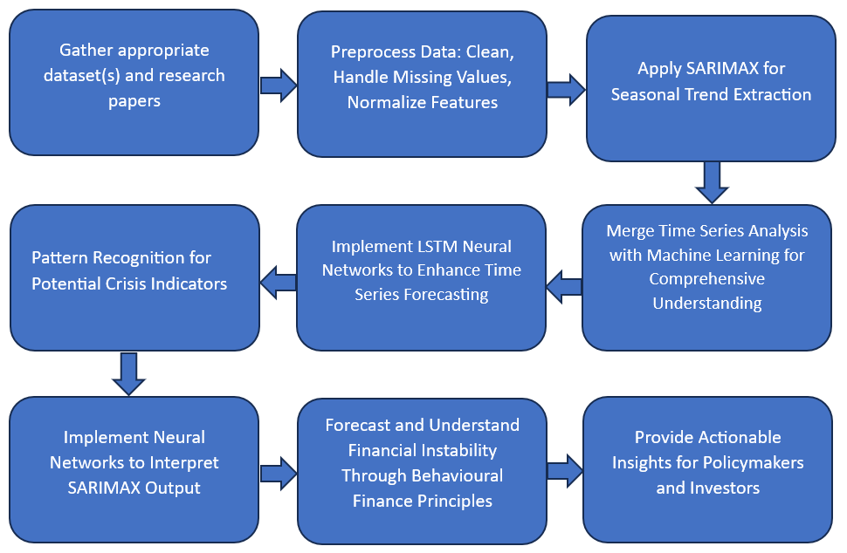
Proposed Methodology

Slide 8
Proposed Methodology
The approach involves:
  Collecting financial datasets and literature
  Preprocessing data
  Applying SARIMAX to detect seasonal trends
  Identifying patterns in crisis indicators using LSTM neural networks
The analysis merges time series with machine learning for depth and employs neural networks to interpret SARIMAX outcomes.
Behavioral finance principles aid in forecasting financial instability, providing actionable insights for policymakers and investors.
Comparisons will be made against historical averages, traditional ARIMA models, and expert financial analysis to validate the approach's efficacy.

Slide 9
Tools and Techniques
The employed tools and techniques are as follows:
Logistic Regression: This method is used for binary classification, predicting the occurrence of financial crises. Logistic regression is effective for its simplicity and clarity in classifying binary outcomes, making it a crucial tool in the project for determining crisis probabilities.
ARIMA (AutoRegressive Integrated Moving Average): This model is used for forecasting time series data. ARIMA is adept at modeling and leveraging historical data patterns, and it's used in the project to forecast various types of financial crises such as banking, systemic, currency, and inflation crises.
SARIMAX (Seasonal AutoRegressive Integrated Moving-Average with eXogenous regressors): SARIMAX is a sophisticated version of ARIMA that includes seasonality and external factors. It's used in the project for handling complex, seasonal financial time series data, where external variables are significant.
LSTM (Long Short-Term Memory) Neural Networks: These are a type of recurrent neural network ideal for sequential data analysis, like financial time series. In the project, LSTMs analyze historical financial data to predict future trends, leveraging their ability to capture long-term dependencies.

Slide 10
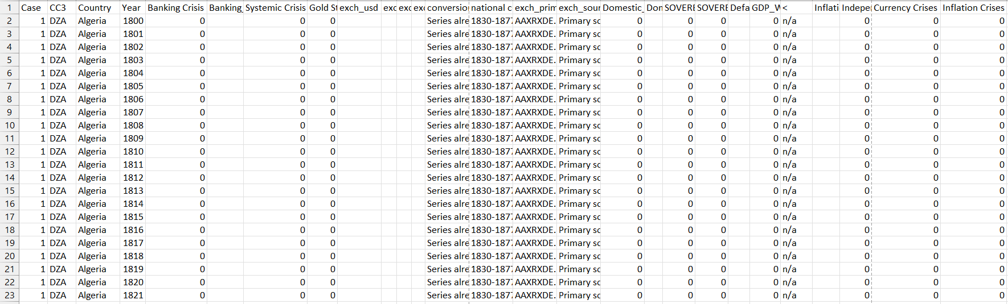
Dataset
Source of the Dataset: Global Financial Crisis Analytics | Kaggle
No. of Observations: 15,192
Screenshot of the dataset
CS6501 Project I PGP, ICER, VIT Bangalore
10

Slide 11
Column/Feature Details of the Dataset
1. Case: A numeric identifier for each record. Each country appears to have a unique case number.
2. CC3: The three-letter country code, following the standard ISO alpha-3 country codes.
3. Country: The name of the country to which the data row corresponds.
4. Year: The year for which the data is recorded.
5. Banking Crisis: Indicates the occurrence of a banking crisis. '0' indicates no crisis, while '1’ indicates a crisis.
6. Banking_Crisis_Notes: Additional notes or explanations about the banking crisis, if any.
7. Systemic Crisis: Indicates whether a systemic crisis occurred in that year. Similar to 'Banking Crisis', '0' likely means no systemic crisis.
8. Gold Standard: Indicates whether the country was on the gold standard in that year.
9. exch_usd: The exchange rate of the country's currency to the US dollar.
10. exch_usd_alt1, exch_usd_alt2, exch_usd_alt3: Alternative exchange rate values, representing different sources or calculation methods.
11. Conversion to USD notes/sources: Notes or sources for the exchange rate data.

Slide 12
Column/Feature Details of the Dataset (continued)
12. Domestic Debt In Default: Indicates whether there was a default on domestic debt.
13. Domestic_Debt_ Notes/Sources: Notes or sources regarding the domestic debt data.
14. SOVEREIGN EXTERNAL DEBT 1 and 2: Indicates whether there was a default or restructuring of sovereign external debt. Different columns might represent different categorizations or time periods of the debt.
15. Defaults_External_Notes: Notes about external debt defaults.
16. GDP_Weighted_default: A measure of defaults weighted by GDP, possibly indicating the severity or impact of the default relative to the country's economy.
17. Inflation, Annual percentages of average consumer prices: The annual inflation rate, measured as the percentage change in consumer prices.
18. Independence: Indicates whether the country was independent in that year.
19. Currency Crises: Indicates the occurrence of a currency crisis.
20. Inflation Crises: Indicates the occurrence of an inflation crisis.

Slide 13
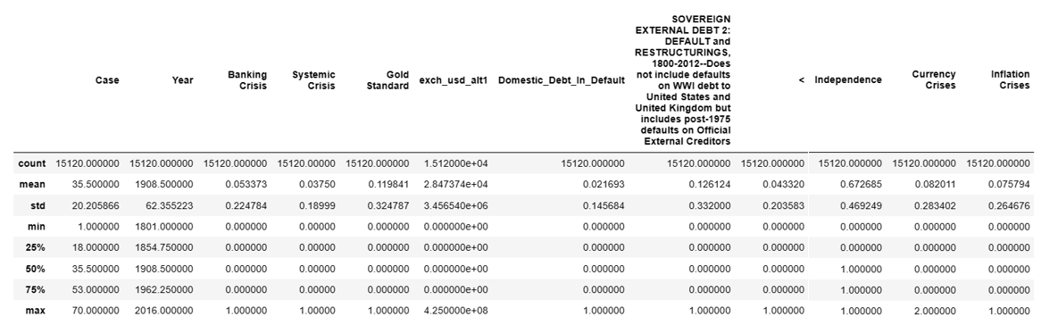
Exploratory Data Analysis
Output of the describe() function, which provides descriptive statistics for the numerical columns in the crisis_data DataFrame.
It includes the count, mean, standard deviation, minimum, percentiles, and maximum values for columns such as 'Year', 'Banking Crisis', 'Systemic Crisis', and others related to financial measures.

Slide 14
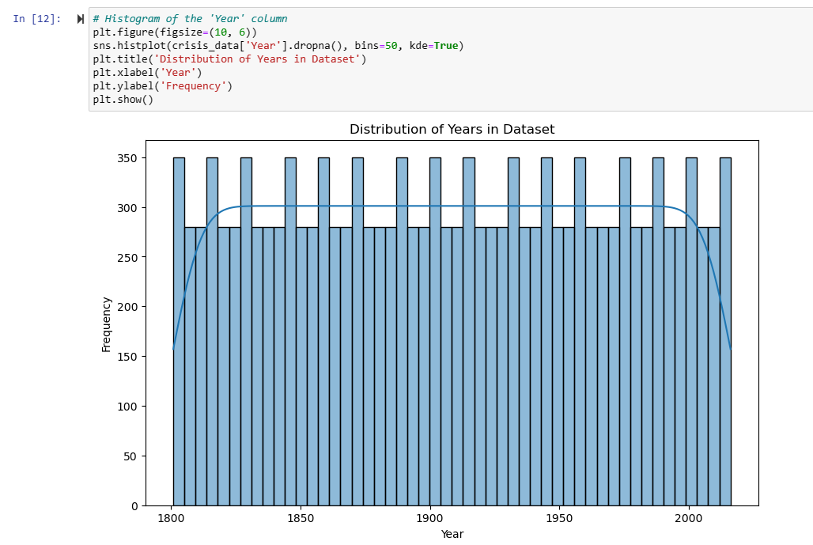
Exploratory Data Analysis
Generated a histogram with a kernel density estimate (KDE) overlay for the 'Year' column of the crisis_data DataFrame, showing the distribution of years and their frequency within the dataset. It is normally distributed.

Slide 15
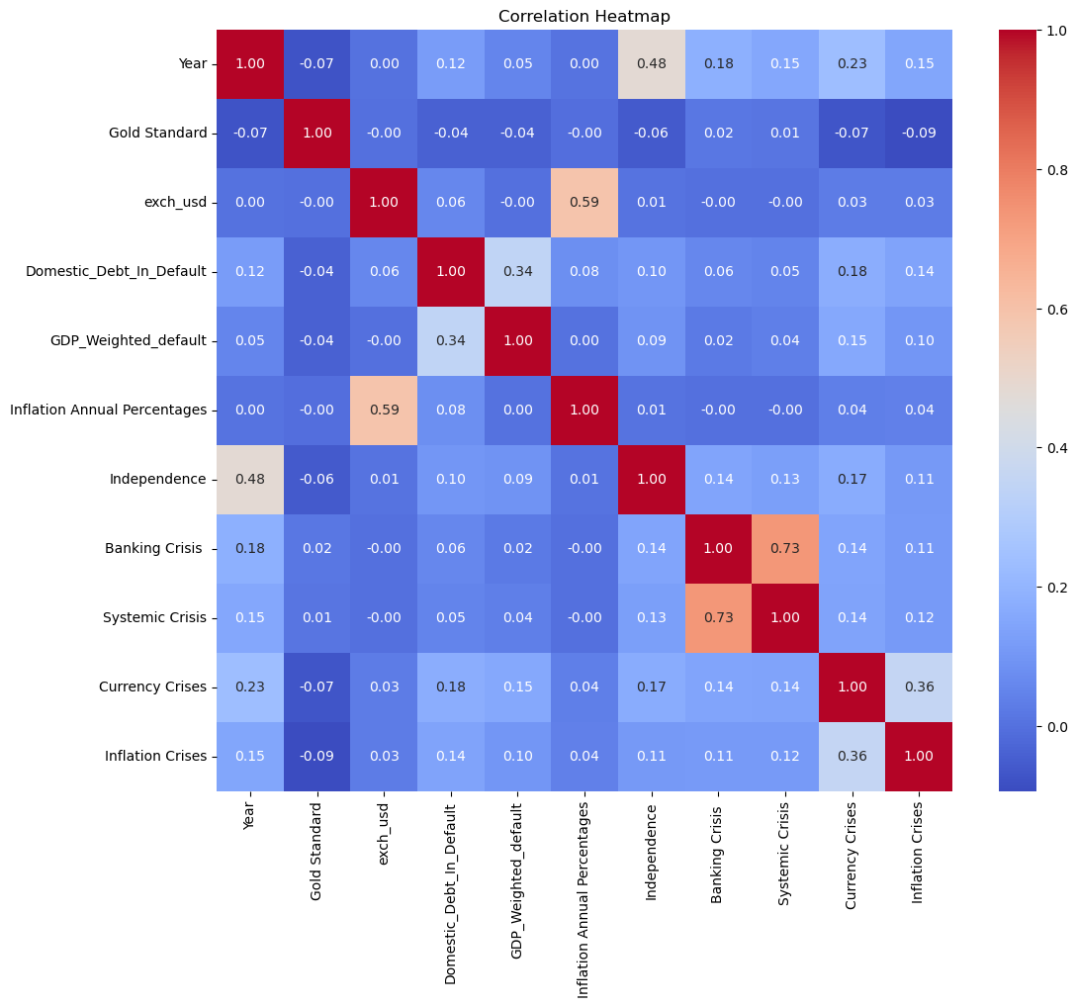
Exploratory Data Analysis
Banking Crisis and Systemic Crisis (0.73): A strong positive correlation, indicating that these types of crises often occur together.
Domestic_Debt_In_Default and GDP_Weighted_default (0.34): A moderate positive correlation, suggesting a relationship between GDP-weighted defaults and domestic debt defaults.
Currency Crises and Inflation Crises (0.36): A moderate positive correlation, implying that currency crises might be linked with inflation crises.
Inflation Annual Percentages and Exchange Rate (exch_usd) (0.59): A strong positive correlation, indicating that higher inflation rates are often associated with a weaker currency against the US dollar.

Slide 16
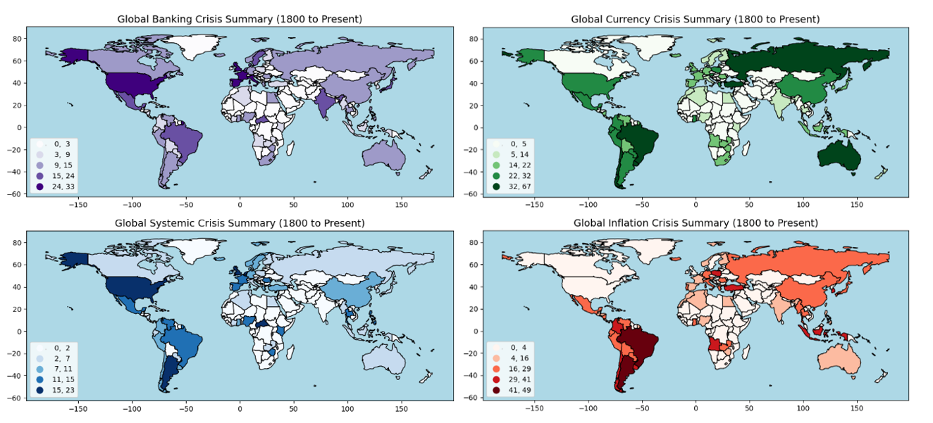
Exploratory Data Analysis

Slide 17
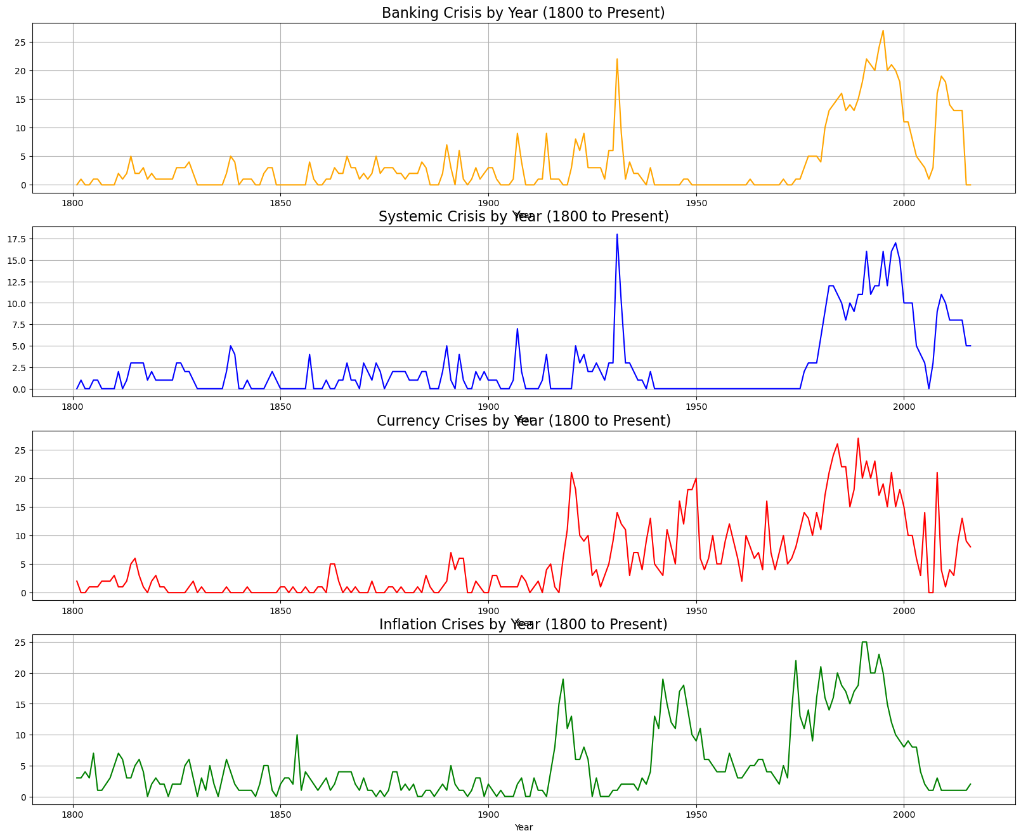
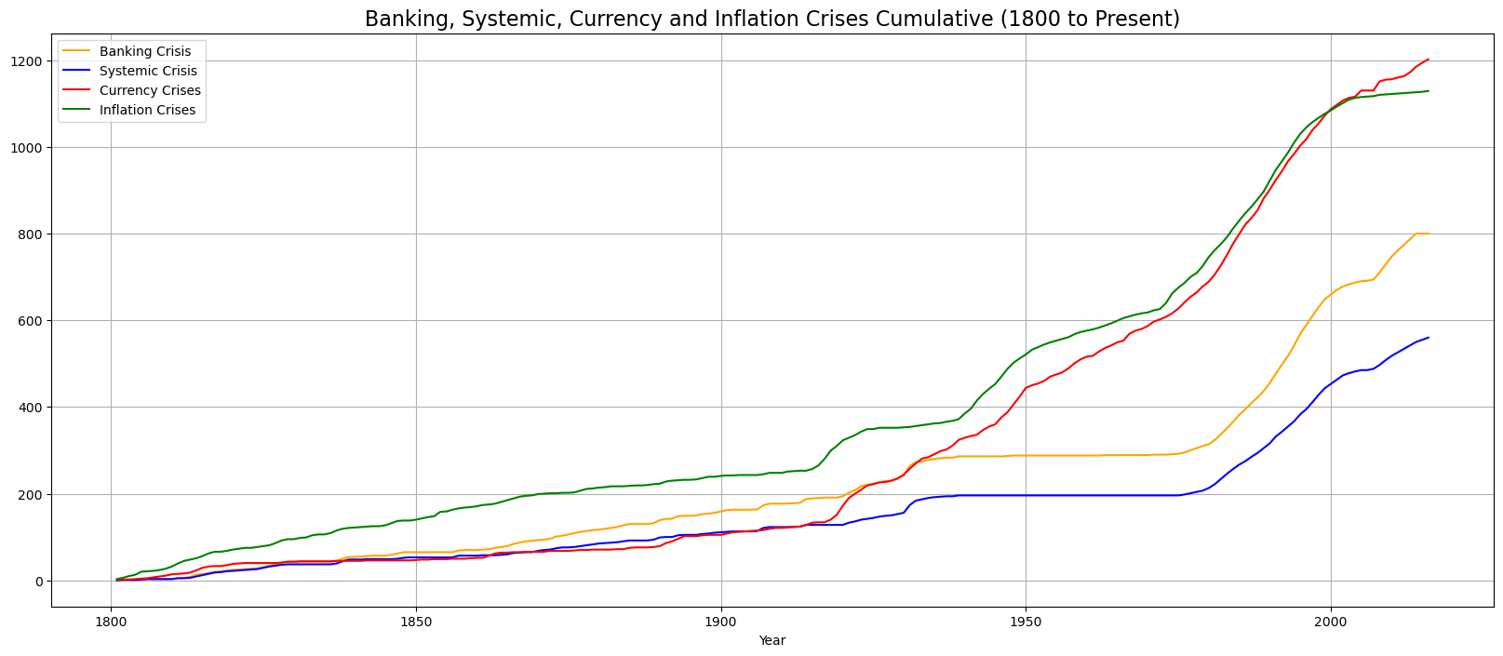
Exploratory Data Analysis
The graph indicates that all types of crises have become more common over time, with inflation crises showing the most pronounced increase. This could reflect various economic trends, policy changes, and evolving financial systems globally. The cumulative nature of the graph underscores the continuing impact and rising frequency of these economic events over time.

Slide 18
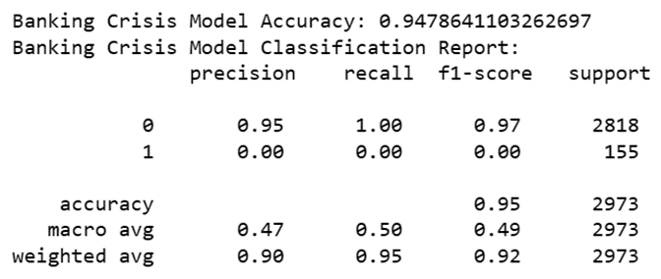
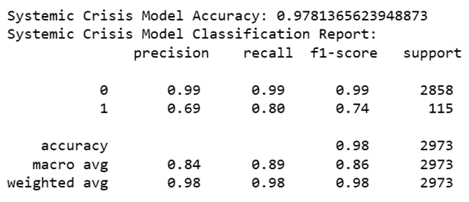
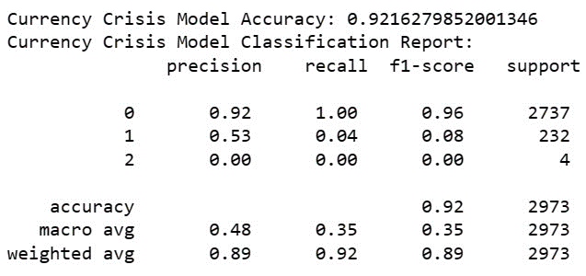
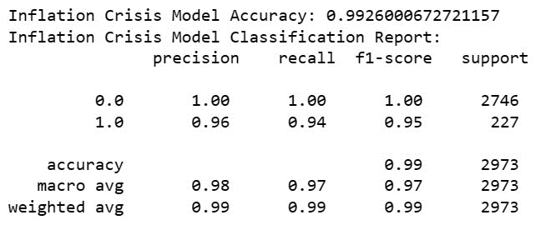
Results and Discussion
Logistic Regression Model

Slide 19
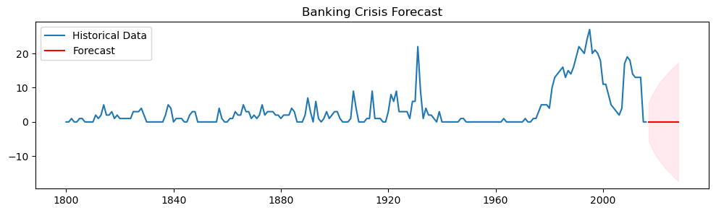
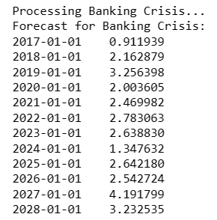
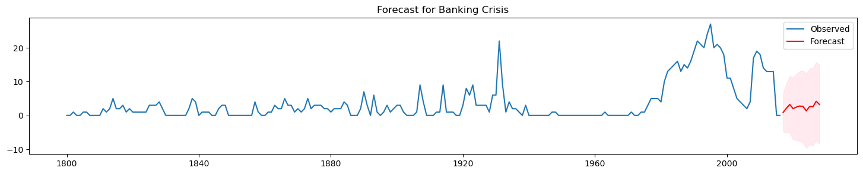
Results and Discussion
ARIMA vs. SARIMAX – Banking Crisis
The graph displays a time series forecast for banking crises, with historical occurrences shown in blue and future predictions in red. The forecast predicts a fluctuating trend of crises severity from 2017 to 2028, with increasing uncertainty over time.

Slide 20
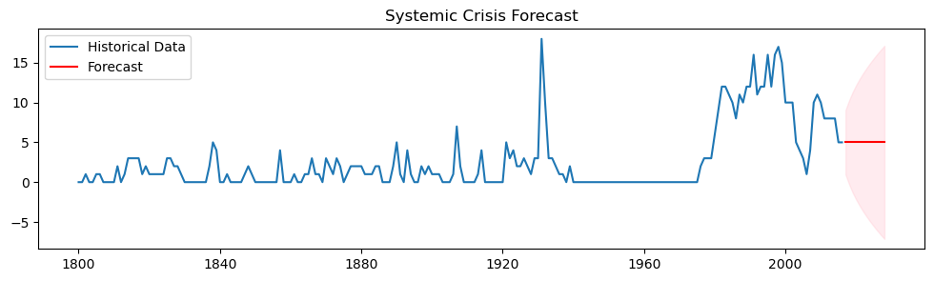
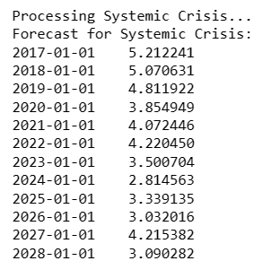
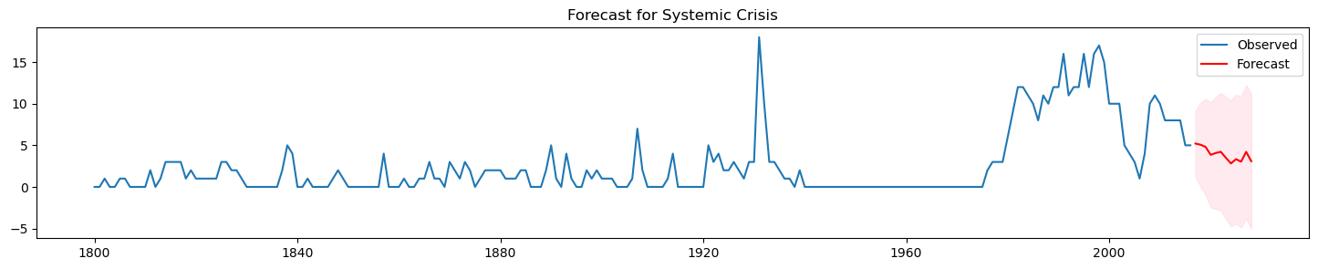
Results and Discussion
ARIMA vs. SARIMAX – Systemic Crisis
The graph shows past systemic crises and projects future trends from 2017 to 2028. The forecast indicates a decrease in crisis severity, with growing predictive uncertainty as time advances.

Slide 21
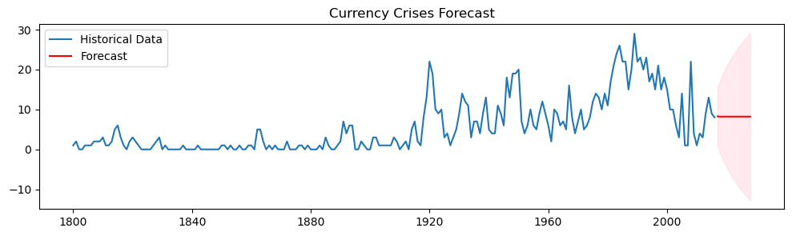
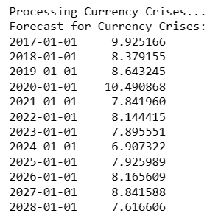
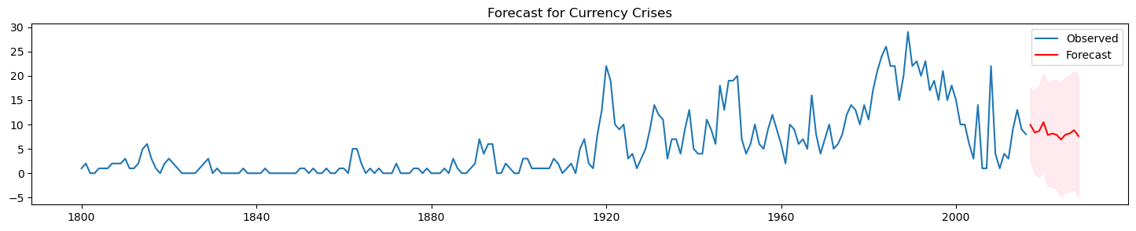
Results and Discussion
ARIMA vs. SARIMAX – Currency Crisis
The image shows a forecast for currency crises, with historical data in blue and predictions in red extending from 2017 to 2028. The model suggests a potential decline in crisis severity, amid increasing forecast uncertainty over time.

Slide 22
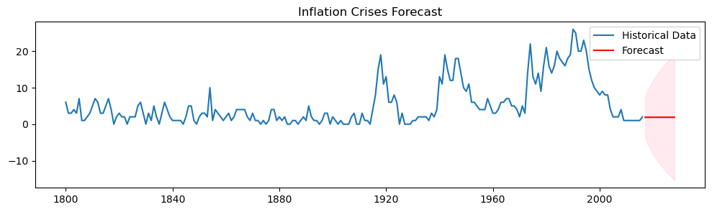
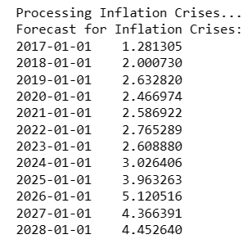
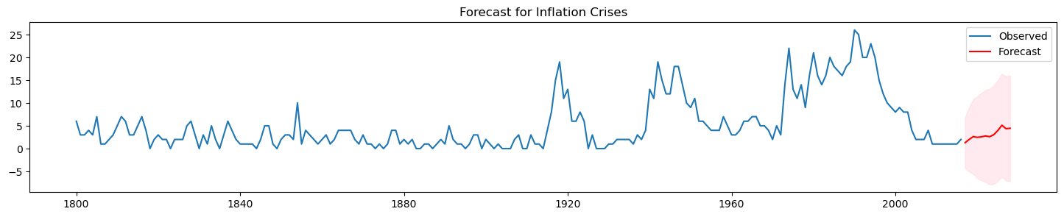
Results and Discussion
ARIMA vs. SARIMAX – Inflation Crisis
The graph displays a forecast for inflation crises, showing historical occurrences in blue and future predictions in red through 2028. The trend predicts an increase in the frequency or severity of inflation crises, with a widening range of uncertainty.

Slide 23
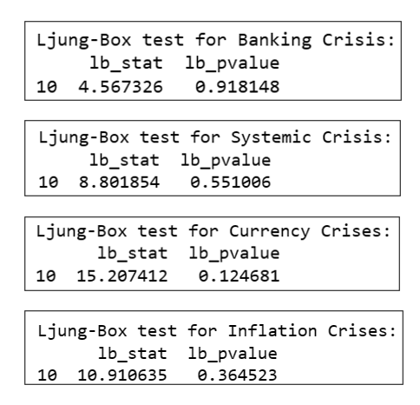
Results and Discussion
The p-value of 0.918148 is very high, suggesting that there is no significant autocorrelation at any of the first 10 lags of the residual time series for banking crises.
The p-value of 0.551086 is also high, indicating no significant autocorrelation at the first 10 lags for systemic crises.
With a p-value of 0.124681, this result is lower but still above the common significance threshold of 0.05, suggesting no significant autocorrelation at the first 10 lags for currency crises.
The p-value of 0.364523 indicates no significant autocorrelation at the first 10 lags for inflation crises.
In all cases, the Ljung-Box test does not provide evidence against the null hypothesis of no autocorrelation, which suggests that the residuals of the time series models for these crises are random, indicating a good model fit without autocorrelation issues.

Slide 24




Results and Discussion
Performance Evaluation of LSTM Model Across Different Economic Crises
The LSTM model's RMSE of 2.42 for training shows a close fit to training data, while 6.31 for testing indicates less accuracy in predicting new data, reflecting its generalization capability.
The LSTM model's RMSE of 0.14 for training and 0.15 for testing suggests high accuracy and effective generalization, with predictions closely aligning with actual values in both datasets.
The LSTM model shows strong fit and accuracy with RMSEs of 0.25 for training and 0.28 for testing, indicating reliable predictions for both training and unseen data.
The LSTM model's RMSE of 0.23 for training and 0.21 for testing indicates high accuracy and effective generalization, with closer predictions to actual values in both training and unseen data.

Slide 25
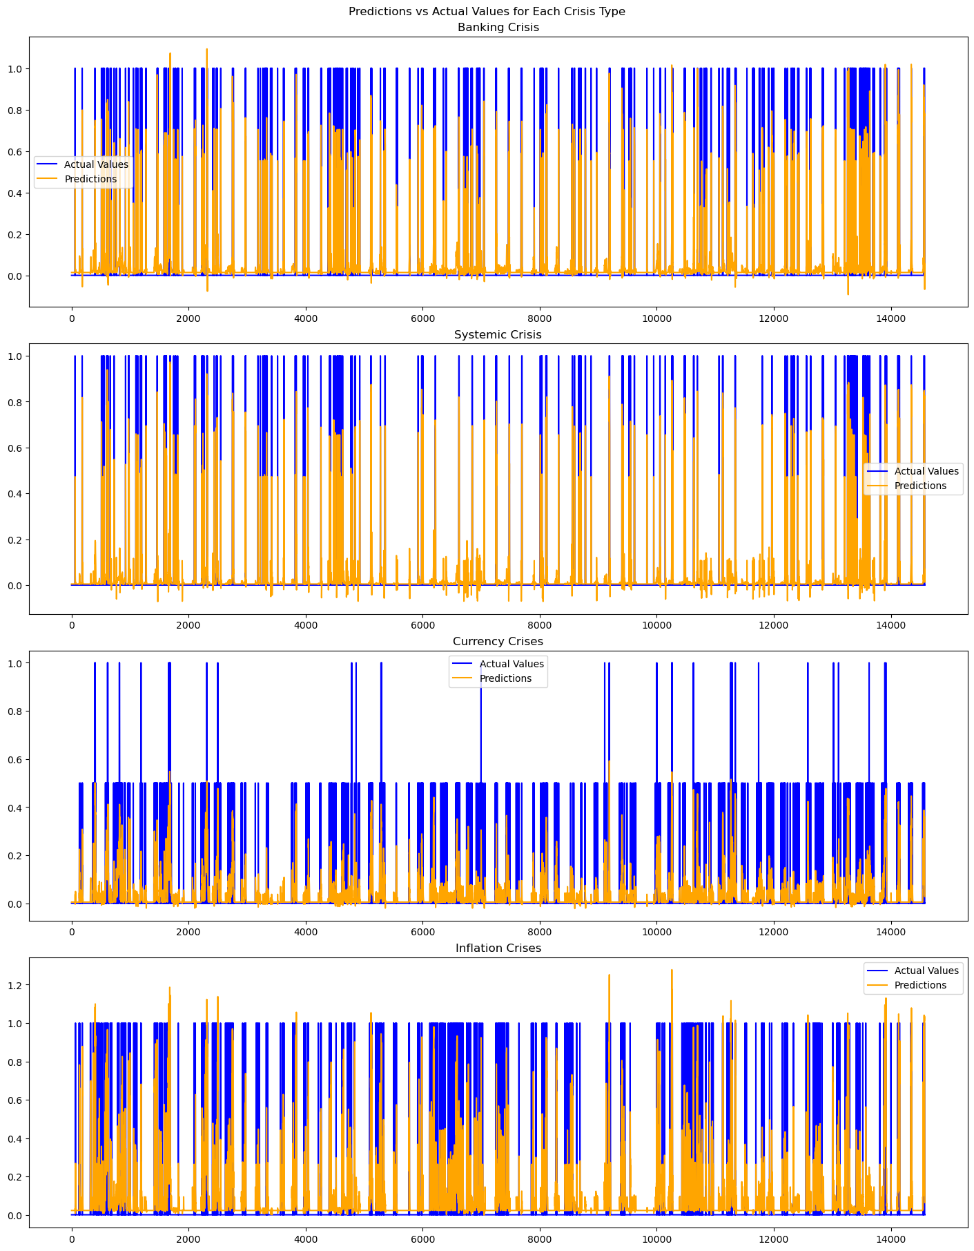
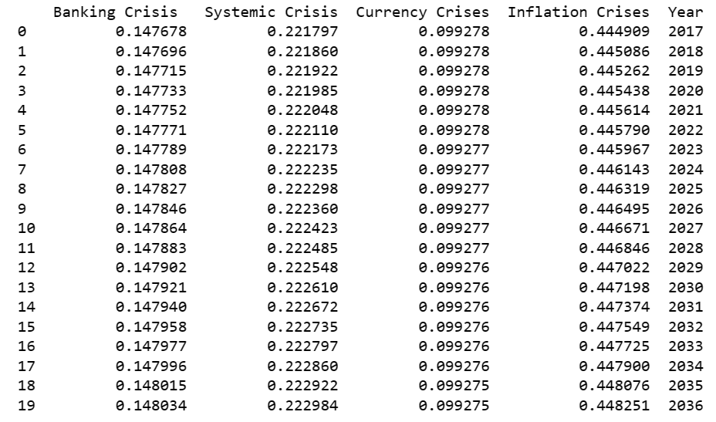
Results and Discussion
Banking Crisis: The forecast probability remains fairly constant, with an initial probability of 14.77% in 2017, showing a negligible rise to 14.80% over two decades. This suggests a stable but persistent risk of banking crises over time.
Systemic Crisis: The probabilities here show a slight but steady increase from 22.18% in 2017 to 22.30% in 2036. The consistency of this rise, although small, might indicate a need for increased vigilance against systemic financial disruptions.
Currency Crisis: There is little variation in the probabilities for currency crises, starting at 9.9277% in 2017 and making a very slight descent to 9.9275% by 2036. The stability in these predictions suggests that while currency crises are not expected to change significantly, they seem to decrease with time.
Inflation Crisis: Starting at a high probability of 44.49% in 2017, the forecast shows a steady increase, ending at 44.83% in 2036. This trend suggests an increasing risk of inflation crises, warranting attention to inflationary pressures and potentially proactive monetary policy.

Slide 26
Conclusion
Validated Logistic Regression, ARIMA, SARIMAX and LSTM models' predictive precision for economic crises.
Demonstrated superior performance of SARIMAX over traditional ARIMA methods.
Revealed potential applications in policy-making and investment strategy enhancement.
Contributed new insights to behavioral finance and crisis prediction literature.

Slide 27
Future Enhancements
Expand datasets to include more diverse economic indicators.
Explore real-time data integration for dynamic forecasting.
Test additional ML algorithms for improved accuracy.
Conduct cross-country analyses for universal applicability.
Develop a more sophisticated model blending for robust predictions.

Slide 28
References : APA format
[1] Harvard Business School. (2018). 2018 Financial Risk and Regulation Survey: Behavioral Finance & Financial Stability.
[2] Tekin, H. (2020). How optimal cash changed by the global financial crisis?. Economics and Business Letters, 9(2), 114- 123.
[3] World Bank. (2020). Global Financial Development Report 2019/2020: Bank Regulation and Supervision a Decade after the Global Financial Crisis.
[4] Lajili, K., Li, T. M., Chourou, L., Dobler, M., & Zéghal, D. (2023). Corporate risk disclosures in turbulent times: An international analysis in the global financial crisis. Journal of International Financial Management & Accounting.
[5] Shehzad, K., Xiaoxing, L., & Kazouz, H. (2020). COVID-19’s disasters are perilous than Global Financial Crisis: A rumor or fact?. Finance Research Letters, 36.
[6] Lolea, I.-C., Petrariu, I.-R., & Giurgiu, A. (2021). ARIMA vs. MACHINE LEARNING IN TERMS OF EQUITY MARKET FORECASTING. The Annals of the University of Oradea. Economic Sciences, XXX(2), 299-308.
[7] Tang, Y. M., Chau, K.-Y., Li, W., & Wan, T. W. (2020). Forecasting Economic Recession through Share Price in the Logistics Industry with Artificial Intelligence (AI). Computation, 8(3).
[8] Liu, J., Yan, R., & Zhang, Y. (2023). Stock Market Forecasting Using the ARIMA GARCH and Random Forest Model During The Russia–Ukraine War. Applied Economics and Policy Studies book series (AEPS), Springer.
[9] Zulkefly, R. N., Karim, A. A., Rahman, A. A., & Sarmidi, T. (2020). Financial inclusiveness and economic growth: New evidence using a threshold regression analysis. Economic Research-Ekonomska Istraživanja, 33(1), 1465-1484.
[10] Hossain, M. J. (2023). Comparative Analysis of ARIMA SARIMAX and Random Forest Models for Forecasting Future GDP in Relation to Unemployment Rate.

